Slide 1



Fall 2025
Department of Computer Science
College of Computer and Cyber Sciences and Software Engineering
MAN-IN-THE-MIDDLE ATTACK ON DIFFIE-HELLMAN
PROJECT
FC 421/332 – Applied Cryptography
:Instructor Name:
Dr. Abdulhakim Sabur
:Student Names:
Lama Alshel – 4110108
Omnia Alharbi – 4210393

Slide 2
TABLE OF
CONTENTS
01
07
INTRODUCTION
CONCLUSION
02
08
THEORETICAL BACKGROUND
REFERENCES
03
SYSTEM DESIGN AND METHODOLOGY
04
IMPLEMENTATION AND DEVELOPMENT
05
RESULTS AND ANALYSIS
06
System Screenshots and Diagram

Slide 3

0.1 INTRODUCTION
1.1 Background Statement
1.2 Problem Statement
1.3 Project Motivation
1.4 Scope and Limitation
1.5 Report Organization

Slide 4
0.1 INTRODUCTIO
Diffie-Hellman creats a shard
key over insecure network.
Lack identity verification
attacker can impersonate.
Many system add digital signatueres to fix this weakness.
DH alone is vunerable to MITM attacks.
Attacker can intercpet,modify,and read massages.
No authentication to confirm who sent the public keys.
Understand real-world attacks paractically.
Learn how to secure DH using signatures.
Show the difference befor & aftar adding authentication.
Foucus on DH ,AES, and RSA signatures.
Includes MITM simulation but not ful TLS or CA.
Demonstrates concept not real word larg scale deployment.
Begin with theorydesign,implementation,results.
Showes insecure version.
Ends with findings and conclusions.
1.1 Background Statement
1.2 Problem Statement
1.3 Project Motivation
1.4 Scope and Limitation
1.5 Report Organization

Slide 5
2.0 THEORETICAL BACKGROUND
2.1 Diffie-Hellman Key Exchange Overview
2.2 Man-In-The-Middle Attack Concept
2.3 Digital Signature and Authentication
2.4 Related Works and Case Studies

Slide 6
1
2.1 Diffie-Hellman Key Exchange Overview:
Tow parties exchange public values to compute a shared key.
Secure mathematically but not authenticated.
Anyone can replace bublic values without being detected.
2.2 Man-In-The-Middle Attack Concept
The attacker sandwiches themself between two users.
Reads and edits messages and generates two shared keys.
Because DH doesn't confirm identification, it functions.
2.0 THEORETICAL BACKGROUND
2
3
2.3 Digital Signature and Authentication
Digital Authentication & Signature.
Verifies that the message was sent by the intended recipient.
Identifies any changes made to the data.
Signs with a private key and verifies with a public key.
4
2.4 Related Works and Case Studies
Studies reveal that DH by itself is insecure.
Authenticated DH is used by modern protocols (TLS).
In unprotected key exchanges, MITM is a frequent assault.

Slide 7
SYSTEM DESIGN AND METHODOLOGY
3.1 Design Approach
3.2 System Architecture Diagram
3.3 Workflow Model (Eddie, Venom, Mallory)
3.4 Tools and Software Requirements
3.5 Cryptography Algorithms Implemented (DH, AES, RSA)

Slide 8
SYSTEM DESIGN AND METHODOLOGY
3.1
SECURE DH+RSA AND INSECURE DH.EXAMINE THE BEHAVIOR OF MITM IN EACH VERSION.FOR A STRAIGHTFORWARD EXAMPLE, KEEP THE DESIGN SIMPLE.
3.2
MALLORY (ATTACKER), VENOM (SERVER), AND EDDIE (CLIENT).MALLORY IS THE CONDUIT FOR MESSAGES.HE VISUAL FRAMEWORK ILLUSTRATES HOW ATTACKS TAKE PLACE.
3.3
EDDIE AND VENOM HAVE NORMAL COMMUNICATION.MALLORY ALTERS AND INTERCEPTS DH VALUES.MALLORY IS BLOCKED BY SIGNATURE VERIFICATION IN THE SECURE VERSION.
3.4
PYTHON 3 FOR SOCKETS AND CODE LIBRARIES FOR CRYPTOGRAPHY (PYCRYPTODOME). A LIGHTWEIGHT TESTING ENVIRONMENT.
3.5
KEY EXCHANGE VIA DH.MESSAGE ENCRYPTION USING AES.DIGITAL SIGNATURES FOR AUTHENTICATION USING RSA.

Slide 9
IMPLEMENTATION AND DEVELOPMENT
4.1 Environmental Setup
4.2 Secure DH + AES Chat Application
4.3 MITM Attack Simulation (Mallory Proxy)
4.4 Digital Signature Integration (RSA Authentication)
4.5 Sample Code Snippets and Workflow

Slide 10
IMPLEMENTATION AND DEVELOPMENT
4.1
4.2
4.3
4.4
4.5
Python 3 client, server, and attack terminals,Different windows to mimic actual communication,For data transport, basic sockets were used.
A shared key is produced by DH, Messages are encrypted from beginning to end using AES,Only functions in the absence of an MITM.
Before transmission, DH values are signed by RSA.The recipient confirms the sender's identity by checking the signature, If Mallory modifies any value, the attack is unsuccessful.
Shows DH key generatetion & signature verification,Clear AES encryption&decryption,Comines all parts into complet workflow.
Mallory acts as a messenger between Venom and Eddie.,Decrypts communications by creating two shared keys,The unsecure version was completely successful.

Slide 11
RESULTS AND ANALYSIS
5.1 Testing Process
5.2 MITM Attack Outcome
5.3 Secure Communication Results
5.4 Wireshark Traffic Visualization
5.5 Findings Discussions

Slide 12
RESULTS AND ANALYSIS
5.4
5.2
Without signatures, plaintext is readable. Only encrypted ciphertext with signatures. Verifies the successful use of AES.
MITM was successful with simple DH. Mallory changed and decrypted every communication.When he attempted to tamper, signature verification was unsuccessful.
5.3
5.1
5.5
Correct interchange of DH parameters and signatures. Securely generated shared AES key. Completely encrypted and verified messages.
First, secure communication was tested.Next, MITM attack behavior was examinedExamined functionality before to and following signing.
Authentication must always be a part of DH. • Security is enhanced by combining DH, AES, and RSA. • After adding signatures, MITM entirely fails.

Slide 13

System Screenshots and DIAGRAM
Fig 1: Code of the DH protocol, generation of the common key and the exchange of thesecret keys.
Fig 2: Code of Signature and verification .
Fig 3: The attacker failed to eavesdrop the messages after verifying the signature.
Fig 4: Success of digital signature and failure of MITM from eavesdropping massages.
Fig 5: Eavesdropping from MITM in massage.
Fig 6: The simulate the success of the attack.
Fig 7: The success of a secure connection using the digital signature .

Slide 14
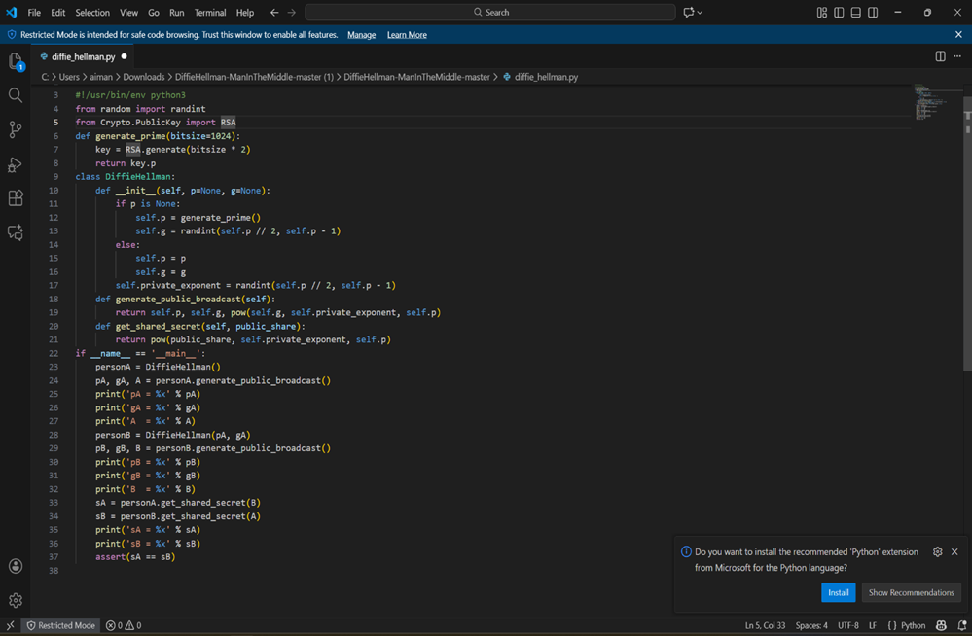
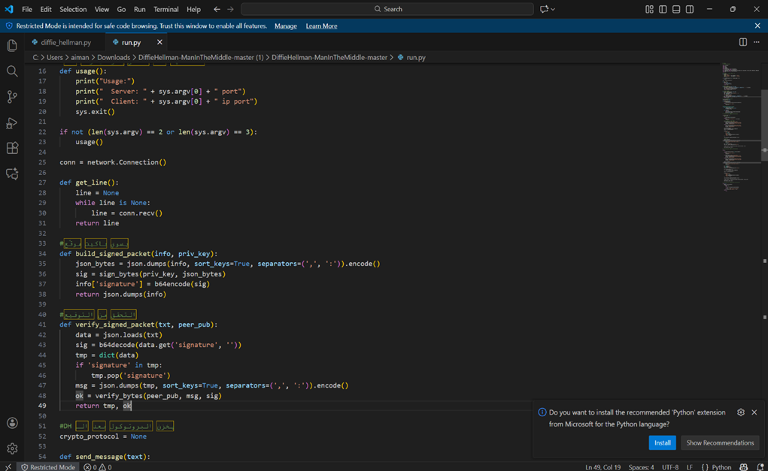
1
CODE OF THE DH PROTOCOL
The part marked in red shows the execution of the function, the generation of special basics, the calculation of public keys and the shared secret key.
2
CODE OF SIGNATURE AND VERIFICATION
This part of the code marked in red is the solution to the MITM problem. Show the build function that the sender's private key to generate a unique digital signature for the DH, so must be ensure the integrity and authentication.

Slide 15
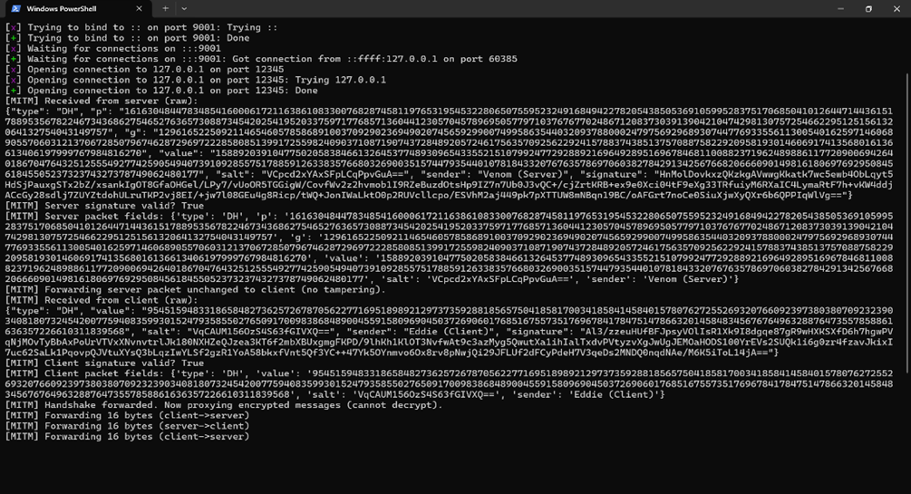
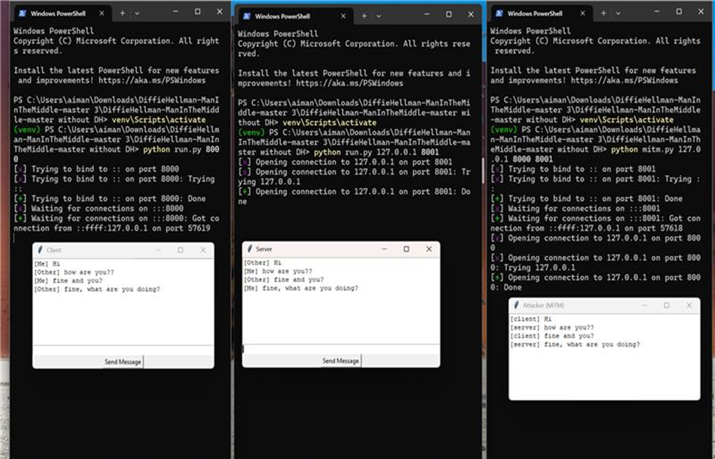
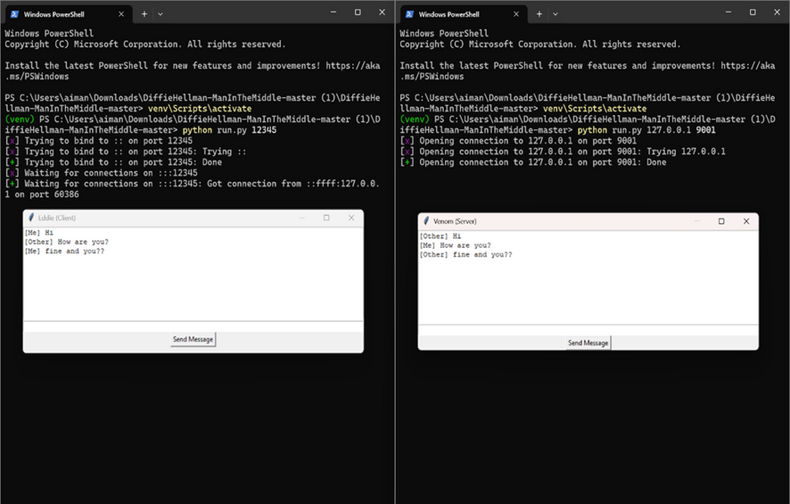
3
ATTACKER FAILED TO EAVESDROP THE MESSAGES AFTER VERIFYING THE SIGNATURE
The main point is the success of the digital signature of the messages from the server and the client.
4
SUCCESS OF DIGITAL SIGNATURE AND FAILURE
shows the success of a secure connection between the customer and the server after mutual verification
5
EAVESDROPPING FROM MITM IN MASSAGE.
the success of the attacker in eavesdropping messages and reading them clearly .

Slide 16
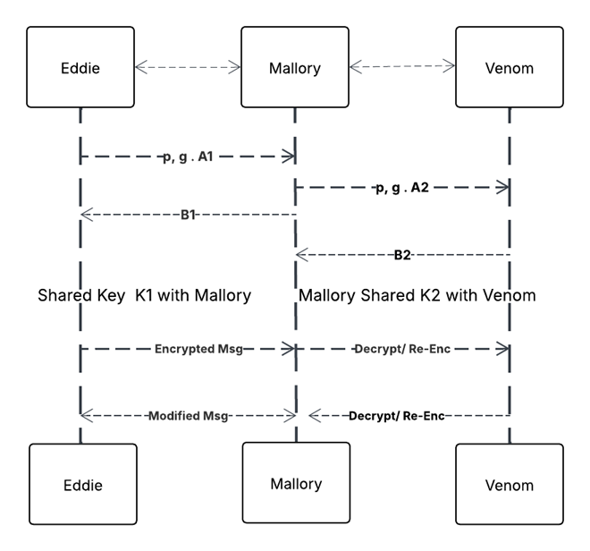
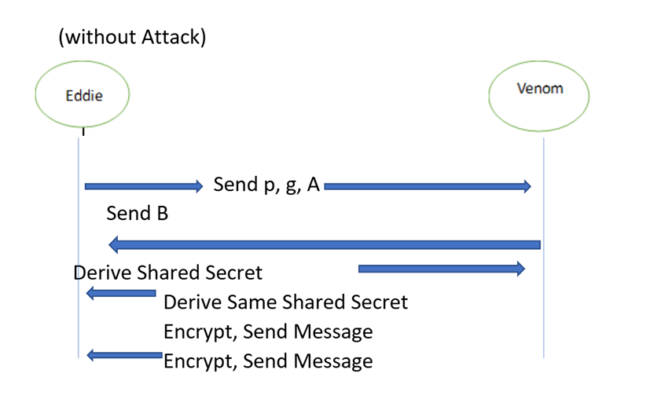
6
SIMULATE THE SUCCESS OF THE ATTACK
The diagram shows the success of the attack in an uncertified version of the protocol, so that the attacker in the middle shows his success in decrypting and reading all DH messages exchanged between the client and the server, which is weak.
7
SUCCESS OF A SECURE CONNECTION USING THE DIGITAL SIGNATURE
This diagram shows the secure and successful connection between the client and the server with the presence of authentication. Keys are exchanged and a secure connection is built by signing an RSA. Any attempt by the attacker to intercept or modify messages is rejected, ensuring the confidentiality of the data.

Slide 17
CONCLUSION
6.1 Achievements Summary
6.2 Lessons Learned
6.3 Abstract

Slide 18
CONCLUSION
6.1 Achievements Summary
6.2 Lessons Learned
Developed a safe conversation program.The MITM assault was successfully stopped.DH + AES + RSA layered cryptography was put into practice.
Big mistakes are caused by small protocol subtleties (JSON order). Precision is necessary for debugging cryptographic code. Appropriate implementation is essential for really secure systems.
6.3 Abstract
Without authentication, DH is susceptible. • Key exchange is protected by RSA signatures. • During testing, the system resisted MITM.

Slide 19
REFERENCE
[1]“GeeksforGeeks,” GeeksforGeeks, 2025. https://www.google.com/url?q=https://www.geeksforgeeks.org/&sa=U&sqi=2&ved=2ahUKEwjLjqqVgaSRAxUd_rsIHWuaHCAQFnoECCQQAQ&usg=AOvVaw3L-dQySvfQ6DeMIJSnFAkl (accessed Dec. 04, 2025).
‌ [2]W. Shen, Y. Cheng, B. Yin, K. Liu, and X. Cao, “Diffie-Hellman in the Air: A Link Layer Approach for In-Band Wireless Pairing,” arXiv.org, 2019. https://www.google.com/url?q=https://arxiv.org/abs/1901.09520&sa=U&sqi=2&ved=2ahUKEwjI7u_MgaSRAxVLOPsDHVhoOJYQFnoECCcQAQ&usg=AOvVaw2uPQYZ9RCWoRUB0FqwXHTa (accessed Dec. 04, 2025).
‌
[3]S. Devi and R. Makani, “Generation of N-party Man-In-Middle Attack for Diffie-Hellman Key Exchange Protocol: A Review.” Accessed: Dec. 04, 2025. [Online]. Available: https://www.ijcsit.com/~ijcsitco/docs/Volume%206/vol6issue05/ijcsit2015060526.pdf
‌
[4]“Securing Text Files: A Comprehensive Study on AES and Diffie-Hellman Encryption,” Ijraset.com, 2024. https://www.ijraset.com/research-paper/comprehensive-study-on-aes-and-diffie-hellman-encryption
‌
[5]Davidmenamm, “GitHub - Davidmenamm/Cyber_Security_Diffie_Hellman_Man_in_the_Middle_Attack: Diffie Hellman Algorithm implementation with man in the middle attack simulation.,” GitHub, 2025. https://github.com/Davidmenamm/Cyber_Security_Diffie_Hellman_Man_in_the_Middle_Attack (accessed Dec. 04, 2025).
‌[6]jaybosamiya, “GitHub - jaybosamiya/DiffieHellman-ManInTheMiddle: Demonstrating a practical attack on the Diffie Hellman Key Exchange protocol, through breaking a secure chat system,” GitHub, 2025. https://github.com/jaybosamiya/DiffieHellman-ManInTheMiddle (accessed Dec. 04, 2025).
‌
[7]“Home,” Openssl.org, 2024. https://openssl.org/
‌
[8]Cryptography, “Welcome to pyca/cryptography — Cryptography 3.0.dev1 documentation,” cryptography.io. https://cryptography.io/en/latest/
[9]H. Eijs, “pycryptodome: Cryptographic library for Python,” PyPI. https://pypi.org/project/pycryptodome/

Slide 20


Fall 2025
Department of Computer Science
College of Computer and Cyber Sciences and Software Engineering
THNK YOU !
Open floor for your question.

